Slide 1
Bootstrap In Actions
Mai Anh Phuong – June 2018

Slide 2
Agenda
Course Overview
Course Objectives
Main contents
Q & A
Assignment.

Slide 3
Course Overview
Sharing some useful components of Bootstrap framework
Sharing keywords and techniques to apply and learn Bootstrap framework
Small assignment to verify our understanding

Slide 4
Course Objectives
Trainees understand main concepts of Bootstrap framework, and be able to build a Web Application using Bootstrap framework.
Trainees can utilize Bootstrap framework strength –
Trainees know how to host Spring Boot application
Trainees can work with Bootstrap framework in real-world project without any additional training

Slide 5
Main contents
What’s Bootstrap framework?
Why Bootstrap framework?
How does it look like?

Slide 6
What’s Bootstrap framework?

Slide 7
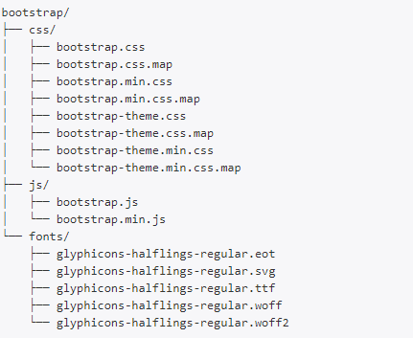
Open-source front-end framework
The most popular HTML, CSS, and JS framework for developing responsive, mobile first projects on the web.
Three main files
bootstrap.css – a CSS framework
bootstrap.js – a Javascript/jQuery
glyphicons – a font (an icon font set)

Slide 8
Why’s Bootstrap?

Slide 9
Easy to use Anybody with just basic knowledge of HTML and CSS can start using Bootstrap
Responsive features Bootstrap's responsive CSS adjusts to phones, tablets, and desktops
Mobile-first approach In Bootstrap 3, mobile-first styles are part of the core framework
Browser compatibility Bootstrap is compatible with all modern browsers (Chrome, Firefox, Internet Explorer, Edge, Safari, and Opera)

Slide 11
Why’s Bootstrap?

Slide 12
Q & A

Slide 13
Assignment

